Slide 1
Cross-Platform Mobile Application Development with Xamarin
Module 3, Lesson 12:
Microsoft Azure App Service
Notes:
Images and excerpts from Xamarin Mobile Application Development by Dan Hermes, published by Apress
http://www.mobilecsharpcafe.com/xamarin-book/

Slide 2
Topics
Microsoft Azure
Azure App Service
Cloud-based mobile features

Slide 3
Objectives
By the end of this lesson you should understand:
SQL Databases
Authentication, authorization
Push notifications
Mobile App Setup Using the Azure Portal

Slide 4
What is Microsoft Azure App Service?
A platform-as-a-service (PaaS) offering of Microsoft Azure
Provides a ready made back-end so the developer can focus on the app
Data storage with Azure SQL Database
API creation
Authentication and Authorization
Push Notifications
Job processing
Notes:
Notes:
App Service aims to automate the creation of very common line-of-business mobile and web functionality
The developers can focus on developing the parts of the app that are unique as opposed to the boilerplate, typical scenarios that must be re-created for each application

Slide 5
How Do I Use Azure App Service?
Azure Portal for configuration of entities
Server SDK in C# or Node.JS
Client SDKs for Xamarin and third-party products
Notes:
Notes:
By following the step-by-step wizard-like process in App Service in the browser, you can add common functionality that’s pre-configured to work with your Azure instance and other apps and services you’ve built in your Azure instance

Slide 6
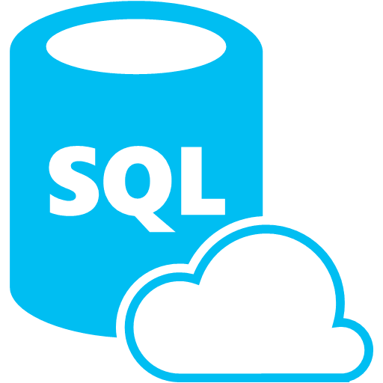
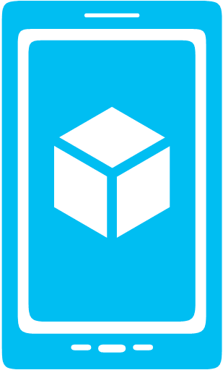


What are Azure Mobile Apps?
Storage
Authentication
Push
Notes:
Notes:
Azure Mobile Apps is an app type of Azure App Service (others types include Web Apps, API Apps, and Logic Apps)
Users don’t really care (and usually don’t know) what a mobile app is using for it’s backend
Users care most about enjoying the app experience
Devs should therefore spend most of their time building the best client experience they can
Azure Mobile Apps helps devs by providing common mobile app backend features in a turnkey manner
Data storage powered by SQL Database (but you don’t have to be a Database Admin to use it)
User Authentication and Data Authorization
Push Notifications (using services built into Android, iOS, Windows, and more)
Other topics not covered in this lesson:
Backend job processing using the scheduler
Backend Logic
Image and text courtesy of Microsoft

Slide 7
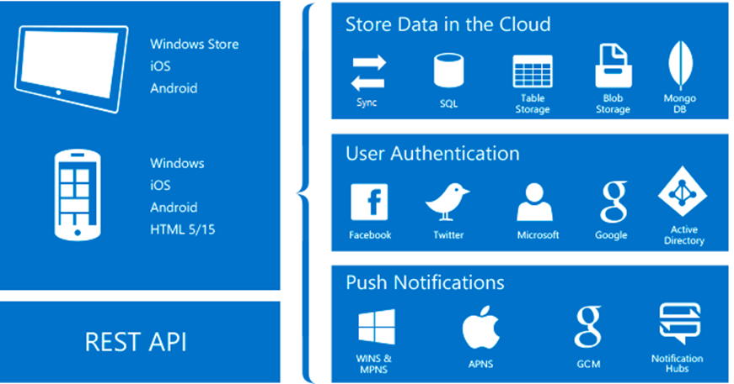
Storage, Authentication, and Push Notifications
Notes:
References:
Image courtesy of Microsoft

Slide 8
Azure SQL Database
Table-based SQL database
Instances configurable using the Azure portal
Data management in:
Azure Portal
SQL Portal (Silverlight)
SQL Management Studio
REST API
Azure CLI Tools
SQL CLI

Slide 9
Azure SQL Database
Threat detection and alerts
Auditing
Email upon anomaly detection
Automatic tuning
Index(create and drop), query parameter, schema recommendations
No administration required
Automatic backups and updates

Slide 10
Easy Tables
Add an Easy Table through App Service
No code to write
Add, modify columns through App Service
Generated app will now have API support for this table
Properties of objects sent to an Easy Table map to columns
Missing columns are added
Notes:
Easy Tables is a feature in App Service that allows for quick connection to an Azure-hosted table
You can create the table and modify its schema in the same wizard-like interface in App Service
When sending records to an Easy Table, any properties on the record are mapped to columns. Any properties that do not map to columns in the table will trigger an addition of a column with the same name as that property
Walkthrough of Easy Tables: https://blog.xamarin.com/getting-started-azure-mobile-apps-easy-tables/

Slide 11
Authentication, Authorization
Authentication verifies who you are
Authorization verifies what an authenticated user can do
Available in mobile apps and web apps
App Service can integrate with many providers:
Azure Active Directory
Twitter
Facebook
Google
Microsoft
Notes:
Notes:
Authentication and authorization capabilities include integration with Azure Active Directory, Twitter, Facebook, Google and Microsoft
This allows for people to use their accounts for each of these sites in lieu of creating an account just for your site or app
The wizard-like, step-by-step process can help set up authentication and authorization for web, mobile and API apps in App Service

Slide 12
User Auth Flow (server)
GOOGLE
CREDENTIALS (via oAuth/WebView)
DEVICE
FACEBOOK
AUTH TOKEN
TWITTER
IDENTITY
MICROSOFT
MOBILE SERVICE
Notes:
Notes:
There are two forms of auth and the first we’ll talk about is server auth
This is a basic Oauth flow
The client device calls a method in the SDK which opens a webview which goes to a specific auth provider
The user authenticates
The provider hands back information to the Mobile Service
The Mobile Service creates an identity which it hands back to the client
Future requests from the client contain that identity (though it needs to be cached locally for app restarts)
The Mobile Service now has Graph access to the provider

Slide 13
Push Notifications
Let app notify of messages or events, including when app not in use
App Service allows for connecting to many providers:
Apple
Google
Windows
Amazon
Baidu
Notes:
Notes:
Push notifications can occur whether or not an application is in use
Push notification capabilities include connecting to Apple, Google, Windows, Amazon and Baidu
Must enter proper authentication credentials (such as an API key for Google) and then the feature will be added to your downloadable apps with sample usage
The wizard-like, step-by-step process can help set up push notifications for web, mobile and API apps in App Service

Slide 14
Push Notification Flow
Mobile Services
Client
Register for push
Send ID
Request push
Push
PNS
Notes:
Notes:
Regardless of what client platform you’re building an app for, this flow is going to be the same
Client talks to a Push Notification Service (such as Google Cloud Messaging, Amazon Device Messaging, Baidu)
Client gets a registration ID that identifies Device and App (but only to PNS)
Client sends reg ID to Mobile Service
Mobile Service can then request the PNS to send a push

Slide 15
Notification Hubs
Separate from Mobile Apps
Can be used regardless of whether you’re storing data in Azure
Extremely scalable push notifications
Cross platform support
Push to iOS, Android, Kindle, Windows, Windows Store
Tags (i.e. tie my registration to this topic or user ID)
Templates (i.e. when I get a push, send it in this format)
Notes:
Notes:
Mobile Services is actually using Notification Hubs behind the scenes
However, Notification Hubs is a separate feature and can be used independently of Mobile Services (or any compute in Azure)
Hubs provides for extremely scalable (millions in minutes) of push notifications
Supports many platforms (iOS, Android, Kindle, Windows, Windows Server)
Tags enable push filtering (who receives it)
Templates enable single request push to all platforms (hubs puts data in the right format for each PNS)

Slide 16
How to Use Azure Mobile Apps

Slide 17
How to Use Azure Mobile Apps
Create a new Azure Mobile App backend
Build, upload, and test the server project
Create a client mobile application
Notes:
Notes:
Easy APIs is a feature in App Service that allows for quick connection to an Azure-hosted API
You can create a blank API in the same wizard-like interface in App Service
To edit the API, you click on the “Edit script” in the API’s “blade” in App Service. Then Visual Studio Online opens in a new tab in your browser, editing a file that defines your API

Slide 18
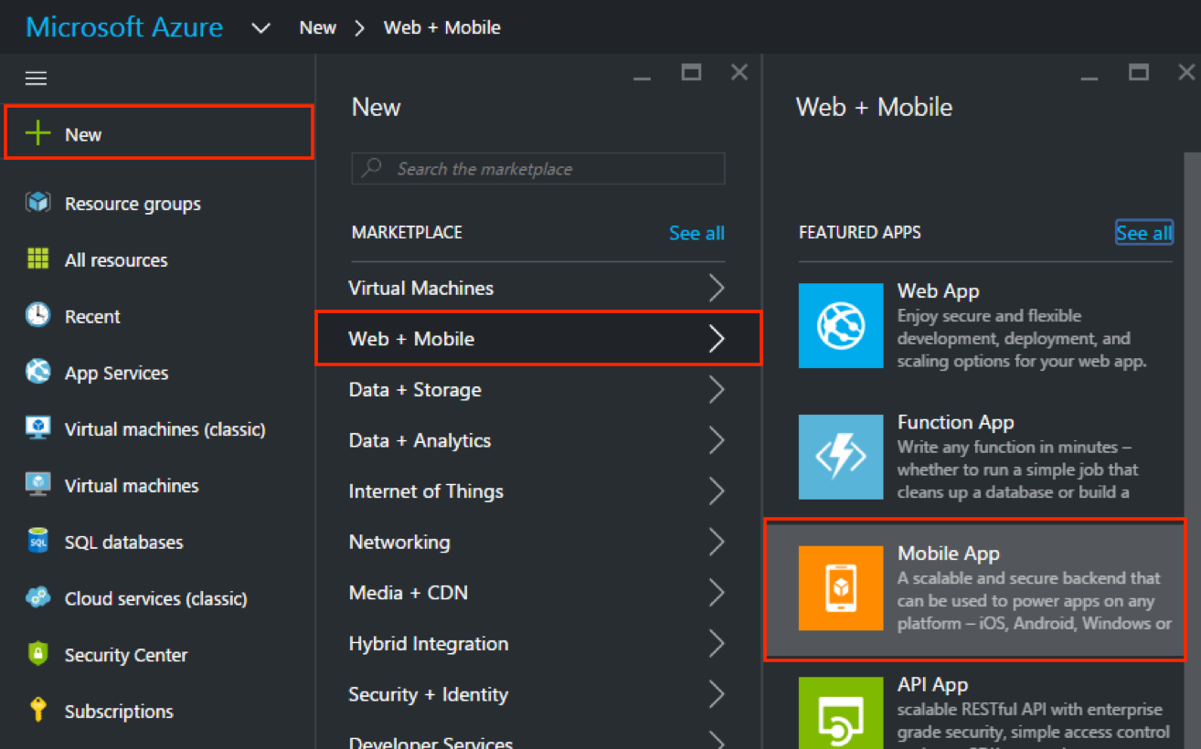
Create a new Azure Mobile App backend
Notes:
Notes:
Select New > Web + Mobile > Mobile App

Slide 19
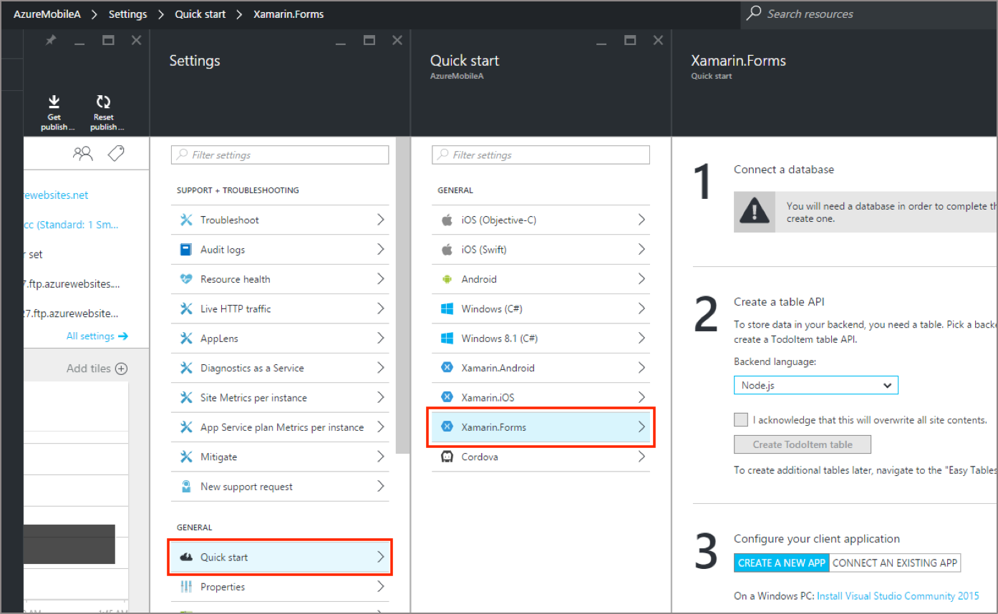
Quick Start in Settings and Connect a DB
Notes:
Notes:
Select New > Web + Mobile > Mobile App
1 Connect to a Database (create a DB connection)
2 Create a table API (C# or Node.js)
3 Configure your client application

Slide 20
Create a Table API using C#
Step 2: Click Download
Open the extracted solution in Visual Studio
Build the project to restore NuGet packages
Deploy the project to Azure

Slide 21
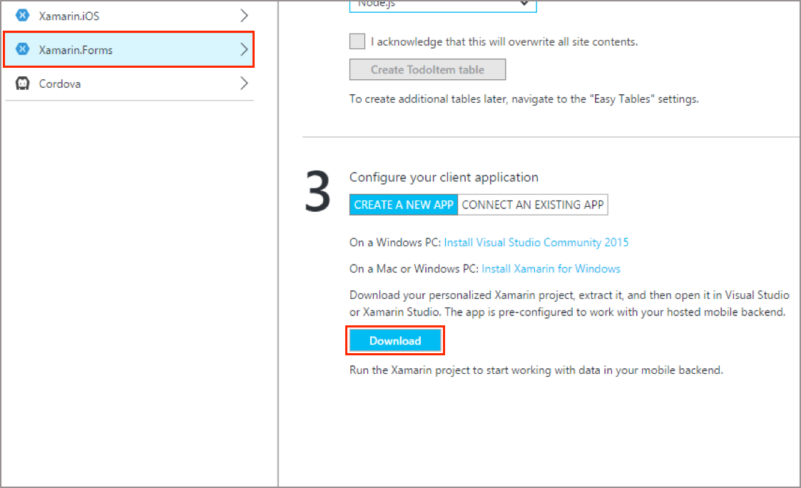
Create a client mobile application
Step 3, click Create a new app
Click the Download button
Open Solution in Visual Studio or Xamarin Studio
Notes:
Notes:
You can download the solution to a Mac and open it in Xamarin Studio, or you can download the solution to a Windows computer and open it in Visual Studio using a networked Mac for building the iOS app.
Extract the project that you downloaded, and then open it in Xamarin Studio or Visual Studio.

Slide 22
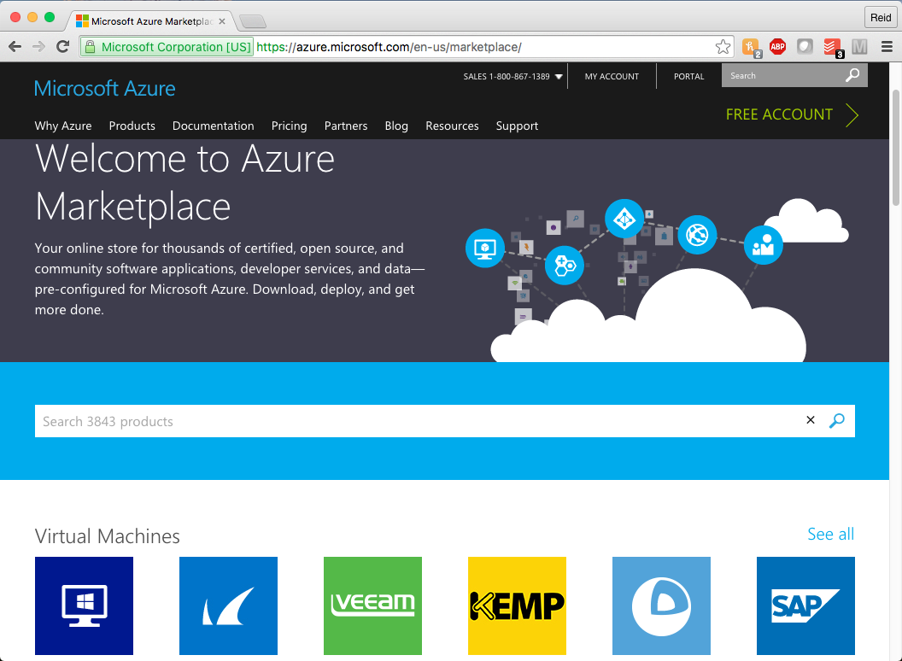
Azure Marketplace
Online store for Azure-configured apps and services
May have components for your app to use or include
API services and apps for many enterprise-level services
Azure Active Directory-connected apps
Notes:
Notes:
Some of the items in the store are free and some are available for a fee. The fees charged can also be based on the level of service, frequently revolving around volume of use
The items in the store are pieces of a larger or enterprise-level app that may be helpful
Email sending/management with SendGrid or Office365
Enterprise-level third-party integration with services like SharePoint, SalesForce and QuickBooks
API access for enterprise-level data services like Bing Search or Global Address Validation
Some items are entire Azure-configured applications or content management systems (CMSes) like WordPress, Umbraco, Drupal, etc.
This can speed up the application development process and save time and money
Most of the items in the Azure Marketplace are built with cloud-computing and Azure in mind, removing some of the common Azure-related development tasks
Azure Active Directory is Microsoft’s multi-tenant, cloud-based directory and identity management service. It provides single sign on access to all integrated apps and services. It includes identity management functionality such as multi-factor authentication, password management, role based access control, auditing and security monitoring and alerting
More on the Azure Marketplace: https://azure.microsoft.com/en-us/marketplace/

Slide 23
Summary
After completing this lesson, you should understand:
SQL Databases
Authentication, authorization
Push notifications
Mobile App Setup Using the Azure Portal
Notes:
Notes:
The Module 3 Lesson 12 Lab should be completed at this time:
https://github.com/MSFTImagine/computerscience/tree/master/Complimentary%20Course%20Content/Module3/Labs
You can add enterprise features to your app through App Service via a step-by-step, wizard-like setup process
After creating a web or mobile app or backend, you can then add features to it
The four features on this slide will be explained in the subsequent slides

